Slide 1
jQuery 3.2.1
14 Mar 18 | Start
15 May 18 | 1: 3-10
Appendix
Online

Slide 2
jQuery
Ch | Date
1 | ddmmmyy
2
3
4
5
6
7
8
Beginning jQuery 3.2.1 2017

Slide 3
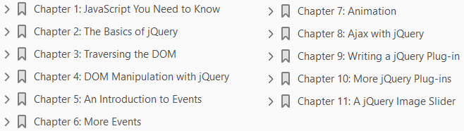

Slide 4
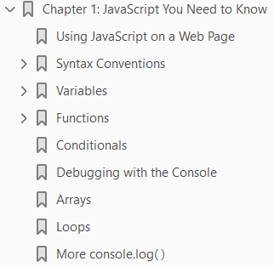
1
JavaScript You Need to Know

Slide 5
Intro
jQuery is a framework that’s built on top of JavaScript, not a language in its own right.
It is possible to write jQuery with barely any knowledge of JavaScript, but it’s not something we would recommend.
If you want to be able to confidently write jQuery plug-ins for your site, or alter plug-ins others have written, you need to be familiar with basic JavaScript.
That is why this book starts with JavaScript that you need to know.
This chapter covers
JavaScript scripts on a web page
Variables and objects in JavaScript
JavaScript functions
Conditionals
Looping over arrays and objects
Debugging JavaScript
If you are familiar with JavaScript, you might feel like skipping this chapter.
That’s fine, but please consider skimming it first to ensure that you are comfortable with everything covered.

Slide 6
Intro |
Resist the temptation to skip to the jQuery parts—because you will struggle with it.
Trust us, in a couple of chapters’ time, this preparation will all seem worth it.
Many developers we’ve helped online have dived into jQuery eagerly before quickly becoming stuck due to a lack of understanding the language jQuery is built on.
When you’re writing jQuery, you’re writing JavaScript, but using the jQuery library.
We cannot stress how important it is that you make sure you are comfortable with the content covered in this chapter before moving on.
We suggest that you try out the code as you read through this chapter.
Don’t fool yourself into thinking you understand it because you’ve read it; there is no substitute for typing out the code yourself.

Slide 7
JS Console
To run the code, we recommend using JS Console (https://jsconsole.com), a tool by Remy Sharp that allows you to execute JavaScript and see the results.
Some alternatives are
JS Bin (http://jsbin.com)
JSFiddle (https://jsfiddle.net)
You can enter the code in the browser and see the results.
This is really useful for short lines of code. Figure 1-1 shows an example of JS Console.
For larger pieces of code, it’s best to set up an index.html page and include your JavaScript file in there.
That would be the way you would really put a site together.
The next section explains how to do that.
Throughout this chapter, several examples use the alert( ) function to demonstrate the value of a certain variable.
This is purely used for demonstration of concepts.
In real life, when you need to check the variable, you wouldn’t ever use alerts—you’d use a browser’s JavaScript console.

Slide 8
JS Console |
The reason for using alerts for basic examples in this chapter is that it’s much easier to get started with.
At this point, there’s no need to load up the developer tools, which take time to get accustomed to.
Once you progress into more complex code later in the chapter, you will spend time exploring the developer tools.

Slide 9
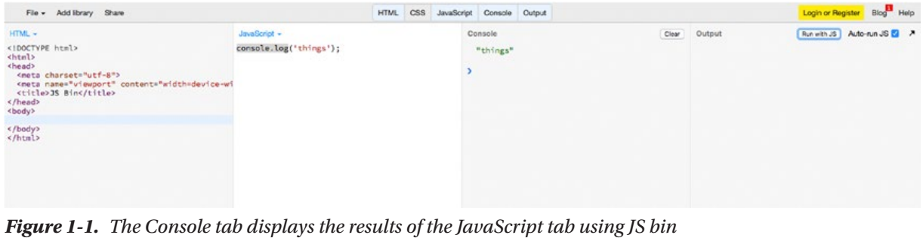
Figure 1-1

Slide 10

Using JavaScript on a Web Page
Within a typical HTML file, there are typically two ways to add JavaScript to a page.
To add some JavaScript,
you can either add your code inline, within a script tag, like so:
Or, you can create an external JavaScript file with the .js file extension and then load it in, through the script tag:
The first location is within the head element, and the second is just before the closing </body> tag.
In the past, scripts were always loaded into the head element, but with performance and page loading speeds more critical than ever, it’s often recommended to place your scripts at the bottom of your page.
This is an approach we side with, too.

Slide 11
Using JavaScript on a Web Page |
The browser renders the page from top to bottom, and when it comes across your scripts, it pauses rendering the page to load in your JS:.
Thus, the page loads slower (or, more importantly, feels that way to the user) because the rendering is blocked by your loading JavaScript files.
Hence, putting the scripts just before the closing </body> tag means that when the time comes to load your scripts, the rest of the page has been loaded.
Before moving on to looking at the language itself, there’s one more thing to note.
Using the HTML5 doctype (<!DOCTYPE html>), you don’t actually need to define the type attribute on your script tags.
Simply using the following is sufficient:
This does not cause issues in older browsers—neither does the HTML5 doctype—and we highly recommend using it.

Slide 12
Syntax Conventions
JavaScript’s syntax is pretty basic and clear, but there are certain subtleties that you will discover on the way.
There’s often more than one way to do things, but the community has certain conventions that have stuck over time.
Semicolons: One convention that we want to mention straightaway is the use of semicolons.
Often in JavaScript, adding a semicolon at the end of a line is optional, and you will see tutorials that don’t do it.
However, the convention is to always use a semicolon at the end of a line, and that’s what we’ll be following in this book.
There are obviously certain circumstances when you can’t use one, and you will see those in this book, but in any situation where a semicolon is optional, we’ll use one.
We recommend you do, too.
White Space: Another consideration to make is for white space.
It is insignificant in JavaScript, so you can lay out code the way you like in terms of white space.
Whenever you are inside a set of braces, you should indent by one tab, but other than that, you will find yourself adapting your own standard.

Slide 13

Syntax Conventions |
Comments: Before continuing, at this stage it’s worth discussing comments.
JavaScript allows you to insert comments in your code.
This is content that will be ignored and not treated as code, so you can put anything you want in comments. Inserting comments is useful for documenting your code.
There are two syntaxes for comments—
one for a single-line comment and
one for a multiline comment
Use comments to remind yourself about a piece of code and what it does, or to provide references for the future you.
After not working on code for a long period of time, comments can really help you remember why you wrote what you wrote.

Slide 14
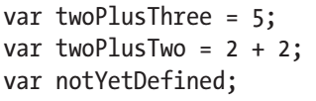
Variables
Often when coding, you want to save the state of something.
Perhaps you want to remember that the current color of your background is red, or the calculation you just performed totaled 33.
JavaScript, like most languages, has variables: a place to store information.
To create a variable, you simply declare it with the var keyword, name it, and then set it to equal to something.
You can also declare a variable without explicitly setting its value.
If you do this, the variable will be set to undefined, a special value in JavaScript that simply means that this variable has not been set to anything.
The following examples declare three variables:
The first variable, twoPlusThree, is set to the value 5.

Slide 15
Variables |
The second, twoPlusTwo, is set to be the result of 2+2.
Here you meet one of JavaScript’s many operators, +.
These operators perform operations on values.
Most of them are obvious. Along with + (addition), there’s – (subtraction), / (division), * (multiplication), and many more.
You’ll meet more throughout the book, so don’t worry too much about them now.
The third variable, notYetDefined, does not have a value and is set to undefined, because we declared a variable (that is, we created a new variable) but did not set a value.

Slide 16

Creating Variables
Variables can contain letters, digits, and underscores.
They cannot start with a number.
So the variable name 0abc is not valid, whereas abc0 is.
Typically, most developers do not use digits in variable names, and either stick to camelCase or the underscore notation.
Of course, once you set a variable to a value, it doesn’t mean you can’t change the value.
All variables can have their values changed.
You do it very similarly to the way you declare a variable, with the only difference being the missing var keyword at the beginning.
That’s only needed when you declare a variable.
This example sets the totalCost to 5, and then updates it again to be 5 + 3 (which you could just write as 8, obviously):

Slide 17
NOTE
Notice our naming convention for variables. We’re using what’s known as camelCase, which means the first word in the variable name should start with a lowercase letter but then every other word in the name should start with a capital letter.
We’ll be using this convention throughout the book.
There are other popular naming conventions, most notably the_underscore_method.
This keeps all words in lowercase and separates them with underscores.
This is more popular in other languages.
The majority of the JavaScript community uses camelCase.

Slide 18

Types
Before continuing, you will notice that so far all the variables have been set as nondecimal numbers.
In JavaScript (and all programming languages), there is the notion of types.
A variable can be any of several types.
The most common are
the number type and
the string type
There’s also the Boolean type, which can only be set to true or false.
When working with JavaScript, you usually won’t have to worry too much about types.
Even if a variable is declared with an integer value (e.g., 5), you can update it to be a string value, as follows:
This changes the type of testVariable from an integer to a string, and JavaScript doesn’t complain at all.
Along with strings, numbers, and Booleans, the two other types you need to concern yourself with (for now) are arrays and objects.

Slide 19
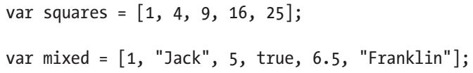
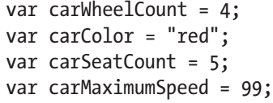
Types |
Both are covered in more detail very shortly, but for now, just know that an array is essentially a list of values.
These values can be of any type, and not all values within an array have to be the same type.
You can create an array by listing values between square braces, like so:
For now, that’s all you need to know about arrays.
The other type, object, is more easily explained with an example.
Let’s say you have the concept of a car in your application.
This car has a certain number of wheels and seats, is a certain color, and has a maximum speed.
You could model this car with four separate variables:

Slide 20
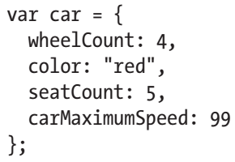
Types ||
It would be easier if you could have just one variable—car—that contained all this information.
This is what an object does.
It’s a way to store lots of information (that is usually related) within one variable.
If you were using objects, the previous code for the car might look something like this:

Slide 21

object Type
The syntax for creating an object is a little different from anything else you’ve seen so far, so let’s walk through it. You create the variable as normal, but then to create an object, you wrap it in curly braces.
An object is a set of key-value pairs, also referred to as properties.
You create these by listing them in the format key: value, putting a comma at the end of all but the last property.
This is a much nicer way to model your code programmatically.
To access properties within the object, you have two choices:
The reason for having two ways of accessing properties is easily demonstrated.
The vast majority of the time, you will be using the first version, the dot notation.
The only time you’ll need to use the second version is if you need to access a key in an object when the name of that key is stored in a variable.

Slide 22

object Type |
This is clearer to see in a demonstration.
Let’s say that the key you want to access, wheelCount, is stored in a variable due to some prior code in your application.
If you want to get at the value at wheelCount, you have to use the second notation, as follows:
This situation doesn’t happen a lot, but sometimes you need to use it. You will see examples of this much later in the book. For now, let’s move on.

Slide 23
Functions
Once you’ve written some code that you might want to use again elsewhere, you have two options.
You could simply copy the code again when you need to use it—but that’s not a good approach.
If you need to change it, you’d have to change it in two or more places.
It would be better to create a function.

Slide 24
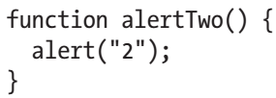

Creating Functions
This lets you reuse code in multiple places, and if you need to make a change, you only have to change it in one place.
Creating a function is very straightforward.
Use the function keyword to denote that you are creating a new function.
You then name it and place the code for your function within curly braces.
All this function does is show an alert displaying “2” on your screen.
Note that the brackets (or parentheses) after the function name are empty.
This means that the function you’ve declared doesn’t take any arguments.
You might declare another function that takes an argument and alerts it, like in the following:

Slide 25

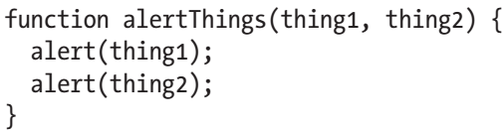
Creating Functions |
This function is passed in an argument, which within the function is a variable you can refer to as something. All you do is alert the value of that variable, as follows:
If you were to run this code in a browser, two alert boxes would pop up, the first showing the text “Jack”.
Once you clicked the alert box to dismiss it, another box containing the number “2” would pop up.
Functions can take multiple arguments, too, such as:
As in the prior example, this also gives you two alerts. The first containing “Jack” and the second “Franklin”.

Slide 26
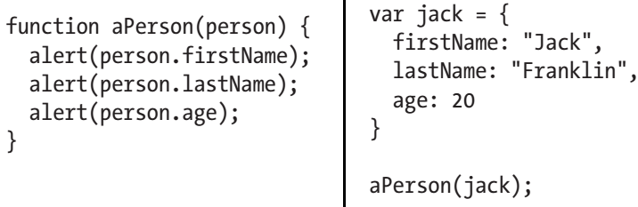
Passing object to a function
Something that’s done very often in jQuery development is to pass in an object to a function rather than multiple variables.
Calling a function and passing in multiple arguments can get confusing; for example:
So a lot of plug-ins—something jQuery makes use of extensively—pass in an object to a function
For example, if you’re declaring a function that takes three to four or more arguments, you’d probably let the function take in an object, as follows:

Slide 27
Passing object to a function |
If you run that code, you will see three alerts, each alerting the properties of the object stored in the jack variable.
This is a pattern used when working extensively with jQuery, so make sure you understand what’s going on here.
To avoid passing in a large number of arguments to a function—which makes it tough to remember which argument is which and the order they go in—developers will often write their functions to accept an object as the only argument.
This means each argument can be named—the order doesn’t matter—and as a developer, it’s much easier to look over the code and see what’s going on.
Rather than cover functions and all their details now, they will be discussed in context in subsequent chapters.
Before moving on, however, you need to understand the concept of functions returning values.

Slide 28
Functions Returning Values
Functions are often used as a way of performing some calculation, such as converting inches to centimeters.
This is a function that you expect to pass in a value, and for it to compute and “return” a value.
The following examples shows how you would do this:
This leaves sixFeetInCM as 182.88, which is 72 multiplied by 2.54.
The reason the sixFeetInCM variable is given that value is because the inchesToCM( ) function is returning its argument—inches—multiplied by 2.54.
By returning the argument, the sixFeetInCM variable is set to whatever inches * 2.54 gives you.
Functions can return absolutely any value.

Slide 29
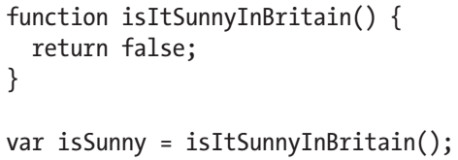
Functions Returning Values |
Often you might want to return a Boolean, either true or false, as follows:
This function will return false, as it should. Let’s face it, it’s never sunny in Britain!
Returning values from functions is something that you’ll use frequently.

Slide 30
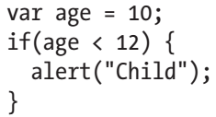
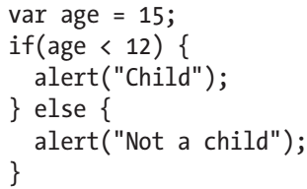
Conditionals
Something you’ll often want to do is run code conditionally.
That is, only do something if something else is true or false.
For example, alert “child” if the age variable is less than 12.
JavaScript has this ability through if statements:
But what if you wanted to do something else if the age is greater than 12? Along with the if statement, you can attach an else onto the end of that, as follows:
Here you’ve met another operator—the less-than symbol, <. There’s also its opposite, greater than, >, as well as “less than or equal to” and “greater than or equal to,” <= and >=, respectively.

Slide 31
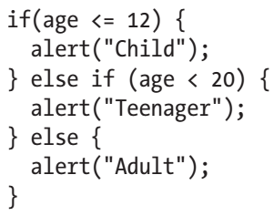
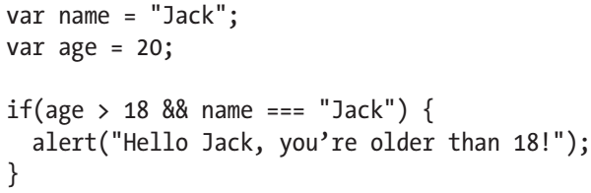
else if
If you want to check multiple conditions, you can also use else if, like so:
Of course, you can use multiple else if statements if required, but usually you won’t need more than one or perhaps two.
Anything that can be evaluated to true or false can be used as the condition of an if statement.
An easier way to get your head around this is to imagine putting some statement within those brackets and in your mind calculating whether this statement is true or false.
If you are able to do that, your condition can be used within an if statement.

Slide 32
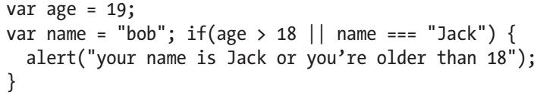
else if |
There’s two new things to discuss here.
First, you have combined two conditionals into one with the “and” operator, &&.
This means the condition will only evaluate to true if both the left and right sides of that condition evaluate to true.
Second, you’ve just seen how to check equality.
In JavaScript, this is a complicated area.
You can use both == and === to check equality, with both having subtle but important differences.
For now, trust us when we tell you to always use ===.
Along with &&, there’s also ||, which is the “or” operator.
Let’s see this in action:

Slide 33
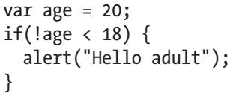
else if ||
The alert will still be shown here, even though only one of the conditional statements holds true.
Age is indeed greater than 18, which makes it irrelevant that the name of this person isn’t Jack, because the or operator will return true as long as one of the conditions is met.
Make sure you understand the difference between || and &&.
The first evaluates to true if either of the conditions evaluates to true; whereas && evaluates to true if both the conditions evaluate to true.
It’s also possible to negate conditionals, meaning they pass if the reverse is true, as follows:
The negation operator, !, reverses the outcome of the conditional. In this example, age < 18 is false, but the ! that prefixes the conditional reverses false to true.
In general, you should try to avoid negations like the preceding one, writing it as age >= 18 rather than !age < 18, because it makes the code easier to read.
The quicker one can scan the code and assess its function, the better.

Slide 34
Debugging with the Console
Earlier, we briefly mentioned the developer console available in browsers.
We stated that once we got to more complex examples, we’d switch from using alert( ) to using console.log( ).
Before making that switch, you need to take a look at the debugging available to you.
Modern browsers ship with a JavaScript console, which is an invaluable tool in the JavaScript developer’s arsenal.
The following list describes how you access the console in all modern browsers:
IE10+: Press F12 and click the Console tab.
Chrome: Alt+Cmd+J on macOS. Ctrl+Shift+J on Windows.
Safari: Alt+Cmd+I on macOS. Ctrl+Alt+I on Windows.
Firefox: Alt+Cmd+K on macOS. Ctrl+Shift+K on Windows.
Opera: Alt+Cmd+I on macOS. Ctrl+Shift+I on Windows.
I use Google Chrome as my browser of choice, all screenshots in this book are from Chrome’s console (unless otherwise noted) but all browsers have a very similar feature set and they look the same, so pick the one that suits you best.
Look at the example in Figure 1-2.

Slide 35
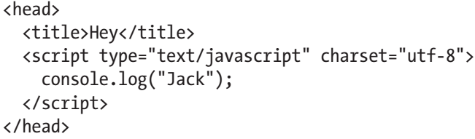
Debugging with the Console |
The console is great for trying out pieces of code, but it really shines for debugging.
The most popular method is console.log( ), which will log data to the console for you to see.
From now on in this chapter, the examples use this method as opposed to alert( ).
When working with complex data structures, console. log( ) provides a much nicer way to view the values of variables.
To see an example, create the following HTML file—name it something sensible—and then open it in a browser with developer tools:
If you bring up the developer console by following the previous instructions, you should see something like Figure 1-3.
You can log absolutely anything to the console and it will know how to deal with it. You’ll see this in action now as you dive into arrays.

Slide 36
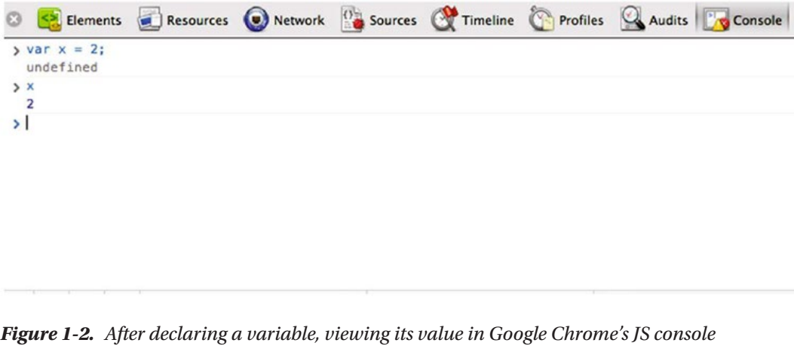
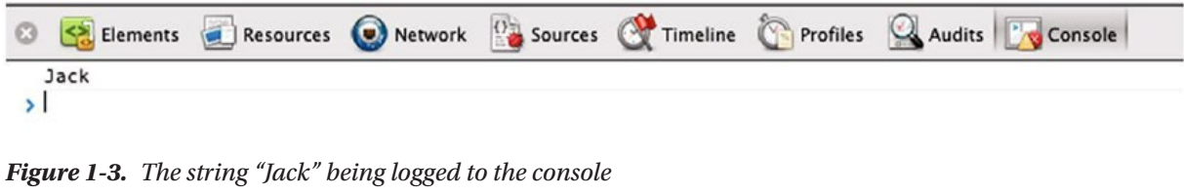
Figure 1-2 || 1-3

Slide 37

Arrays
Before moving on to jQuery, it’s important to cover arrays.
An array is simply a list of values, as mentioned earlier.
The following is an example of an array:
That’s about as much as covered earlier, so now it’s time to delve further.
You can access a single element in an array by adding a number in square brackets after the variable, like so:
Notice here that the element at position 1 is not “Jack”, but “Jamie”.
This is because arrays are zero-indexed.
That is, the first element in an array is actually at position 0, not position 1.
This can take some time to get used to if you’re not a programmer, but once you get the hang of it, it will become second nature.

Slide 38
Arrays |
So to get the name “Jack” from the array, you would need to use classMates[0].
You can find out the length of an array by using classMates.length, which in this case returns 4.
As a quick test, how do you think you might get at the last element of an array when you don’t know the length? You’d do it like so:
See if you can figure out how this works without reading the explanation first.
classMates.length gives the array length, which is 4.
So to get the last item in the array, you need to get the person at the last index, which is the length minus one, down to the fact that the first element is at position 0 and not position 1.

Slide 39
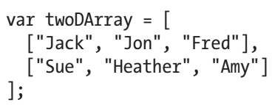
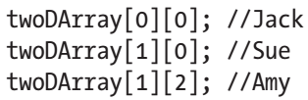
Two-dimensional Arrays
Remember, JavaScript arrays can contain absolutely anything within them, including objects and also other arrays.
Here’s what you might call a two-dimensional array, an array in which each element is itself an array:
To access elements in an array of arrays, use the square bracket notation, just as you used it previously, to get the second element in the classMates array, classMates[1]:
The first set of square brackets grabs the element of twoDArray, so twoDArray[0] returns the array containing "Jack", "Jon", and "Fred".
twoDArray[1] is the array containing "Sue", "Heather", and "Amy".
This isn’t something you’ll have to do very often, but it’s worth showing you in this introduction to JavaScript because it really makes certain that you understand the basics of arrays.

Slide 40


Array Operations
To add an element to an array, use the push( ) method:
Note that push( ) will always add an element to the end of an array.
Unfortunately, there’s no such method for easily removing items in arrays.
You can use the delete operator, which at first glance does everything you need:
While this looks like it will work, it actually doesn’t. If you perform that command on your initial array of “Jack”, “Jamie”, “Rich”, “Will”, this is what happens:
This is the crucial aspect of delete: it does not remove the element from the array. It simply replaces the value at that index with undefined.
Hence, to actually completely remove an element from an array, you have some more work to do.
You will revisit this later in the book when this problem actually occurs.

Slide 41
Loops

Slide 42
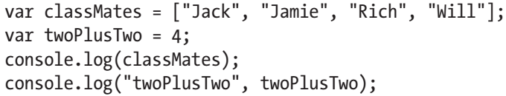
More console.log()
You used console.log( ) when looking at arrays, but you’ve so far only used it in the most basic form by passing it one argument that you expect it to log to the console.
It’s much more powerful than that.
You can pass in multiple arguments and it will log them all out—on the same line.
For example:
You will see the output shown in Figure 1-4.
You can see that logging out the classMates array makes it completely clear what it contains, and this is exactly what console.log( ) is there for.
If you want to output more than one thing on one line, you can easily do that by passing in multiple arguments to the function.
The second example logs out the string "twoPlusTwo" and then the variable twoPlusTwo.
We often do this when logging a lot of values, so it’s clearer in the console which line is logging what. We will be using console.log() heavily throughout this book.

Slide 43
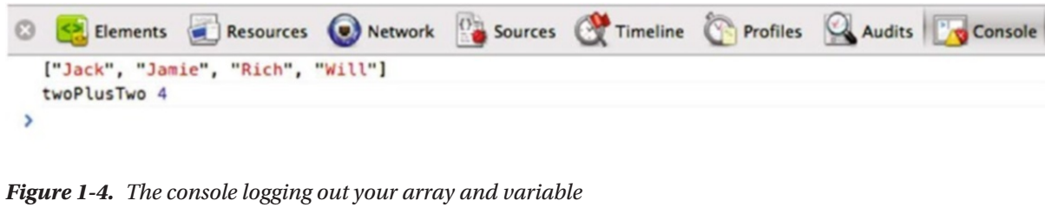
Figure 1-4

Slide 44
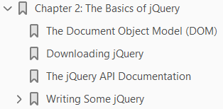
2
The Basics of jQuery

Slide 45
Intro
jQuery is a powerful and complex library that was first released in August 2006, although the initial idea came much earlier.
The first time anything posted online that hinted that a potential library was forming was on August 22, 2005.
jQuery’s founder, John Resig, posted a blog post titled “Selectors in JavaScript” (http://ejohn.org/blog/selectorsin-javascript/), which demonstrated Resig’s idea that we could interact with elements in JavaScript using CSS selectors.
This demonstrated a new idea that would eventually form the beginnings of the library we know and love today.
jQuery was officially announced at Bar Camp NYC in January 2006 and it quickly took the Internet by storm, topping the front pages of many popular sites, including Digg and Delicious.
jQuery grew and grew, and hit stable v1 in August 2006. From there it has continued to grow.
Its impact on web development cannot be underestimated, and its impact on the community view of JavaScript is even more important.

Slide 46
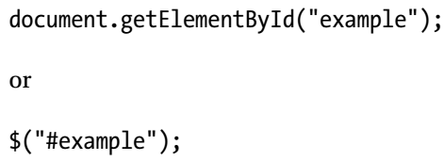
Intro |
jQuery made JavaScript more accessible to the “average” developer.
For example, which of the following two syntaxes do you prefer for selecting an element by its ID?
Suddenly, if you knew how to select elements with CSS, you could transfer that knowledge to JavaScript by using jQuery.
jQuery provided a reliable cross-browser method of interacting with the Document Object Model.
Before we get much further, it’s time to discuss the DOM.

Slide 47
Agenda
In this chapter, you will do the following:
Look at how browsers represent web pages through the Document Object Model (DOM).
Look at DOM nodes and the terms
Parent
Child
Sibling
in the context of a web page
Download the jQuery source and include it in a web page.
Write some code that utilizes jQuery.
Explore in detail how that code works, and meet some of jQuery’s features.
Explore the jQuery API documentation and how to use it to answer any issues you might have.

Slide 48
The Document Object Model (DOM)
When you look at a web site, you see a lot of elements grouped together and styled to form what’s in front of you.
To be able to access those elements through code to remove, add, and manipulate them, you need some form of interface—a representation of the elements on a page that is structured and follows a set of rules on how to model them.
This is what the DOM is. The DOM also lets you capture browser events—such as
a user clicking a link
submitting a form
scrolling down the page
In Chapter 3 you will see how to use jQuery to traverse the DOM.
In the early days of the Web and browsers, standards in terms of JavaScript implementation were not very clear.
This led to browsers implementing features in different ways, which caused developers issues.
It led to any JavaScript having to effectively be written multiple times for the different browsers that had different implementations—primarily Netscape and Internet Explorer (IE).
Thankfully, as things progressed, browsers adopted the same standards and things settled down.

Slide 49
The Document Object Model (DOM) |
However, the level at which browsers support the DOM can still cause issues today.
In particular, we’re not free of the older versions of Internet Explorer, which do not support the DOM to the level of more-modern browsers.
This is one reason jQuery is so valuable:
everything it offers works just as well in an older version of IE
as it does in the latest release of Google Chrome or Mozilla Firefox
It is important to note that the last version of IE is 11;
Microsoft Edge is now the default browser in Windows 10.
Before continuing with jQuery (you’ll get there soon!), it’s worth taking a moment to introduce how the DOM works.

Slide 50

How DOM works?
When a page is loaded, the browser generates a representation of what’s on the page, and for each element, it generates one or more nodes that represent it.
There are multiple types of nodes, and were this a book purely on DOM interaction with JavaScript, we’d be covering the DOM in more detail.
As we mentioned in the first chapter, we feel it’s very important to give people new to jQuery a solid introduction to the foundations on which jQuery is built.
We’ve already covered JavaScript in great detail, and we feel it’s important to look at the DOM.
When a browser forms a representation of the current page as the DOM, every element is a node.
Let’s say you have a paragraph with some text in it, such as:
The text node would be a child of the element node because it resides within it. In a typical page, there are a lot of nested nodes.
That’s not one node, but two nodes. There’s a text node that contains “Hello World” and an element node that’s the paragraph.

Slide 51
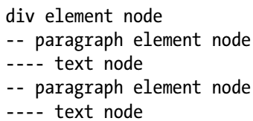
How DOM works? |
A div with two paragraphs that both have text within them is structured like so:
The two paragraphs in this instance are siblings because they have the same parent node.
The paragraphs are children of the div, but the text nodes are not child nodes because they are not direct descendants of the div element.
They are child nodes of the paragraph nodes.
There are three main types of nodes that you need to know:
Element
Text
Attribute
Let’s say that you gave the paragraph a class, such as:

Slide 52
How DOM works? ||
There are now three nodes at play:
The element node representing your paragraph
A text node that contains the text “Hello World”
An attribute node that states this element has class="intro“
Somewhat confusingly, an attribute node is not considered to be a child of an element node.
Between those elements, they make up the vast majority of most of the web pages out there.
Before (finally) getting to jQuery, make certain that you understand the following terms because they are used continually throughout the book:
child node: A node that is a direct descendant of another node, usually an element node
parent node: A node that has direct descendants (e.g., children)
siblings: Two nodes that share the same parent

Slide 53
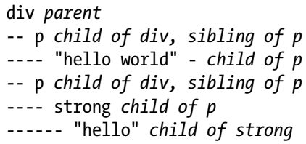
How DOM works? |||
And just to iterate one final time, the following is a visual representation:
Understanding the terms “child,” “parent,” and “siblings” will be very important later in the book when we discuss selecting elements with jQuery, so make sure you’re confident about their meanings.

Slide 54
Downloading jQuery
After a lot of preparation, you are ready to dive into jQuery and use it for the first time.
The best place to start is the jQuery web site at http://jquery.com (see Figure 2-1).

Slide 55
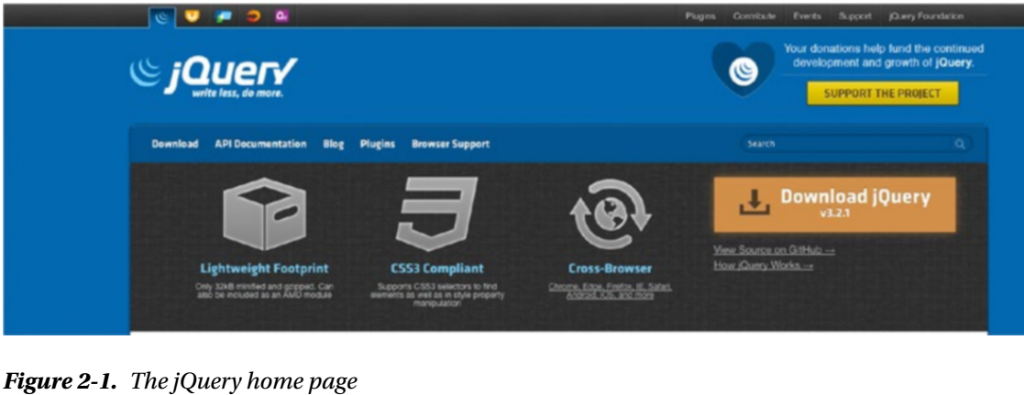
Figure 2-1

Slide 56
The jQuery API Documentation
If you are using jQuery, you need a good source from which to learn what each API does.
The jQuery documentation (http://api.jquery.com) lists every method jQuery provides.
Another reason jQuery has become so successful is its documentation, which is fantastic.
We seriously cannot overstate how good we think the documentation is (see Figure 2-2).
There are a couple of ways to find what you’re looking for on the web site.
If you know exactly which method you want, using the search box located at the top right of the screen is by far the quickest way.
If you’re not certain about exactly what you want—perhaps you’re looking for a method to do something particular, but you’re not sure if it exists—you can browse the jQuery API categories listed on the left side of the screen to narrow your search.
You don’t need to look at these yet, but you will return to the API many times.
Put it on your bookmarks bar, or find an easy way to browse it, as you will use it a lot.

Slide 57
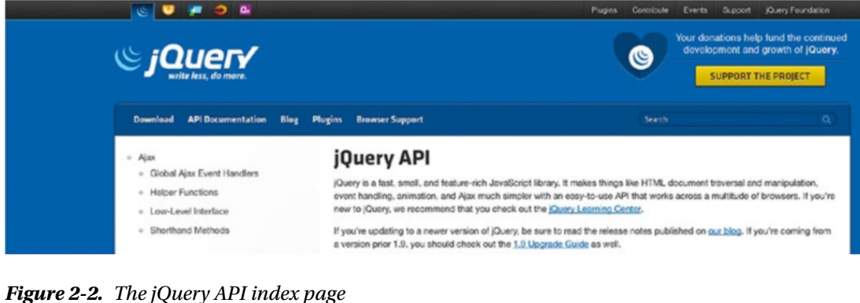
Figure 2-2

Slide 58
Writing Some jQuery
Save your downloaded jQuery file as jquery.js in a new folder on your machine.
You’re also going to add an HTML file to this folder, so create an index.html page, too.
Finally, you want to write all the JavaScript in an individual file, so create app.js.
This code is available within 02/code/ex1.
Load the HTML page in your editor of choice—I personally use Vim we highly recommend Sublime Text 2 (www.sublimetext.com/2), Visual Studio Code (https://code.visualstudio.com), or Atom (https://atom.io), all of which run on Windows, macOS, and Linux—and add the lines shown in Listing J-1.
This is just a basic HTML page, nothing fancy. Take a look at the two <script> tags
First, load in jQuery and then load in the app.js file, which is currently blank.
Now that you have your page, go ahead and load index.html in your browser.
You won’t see anything yet, other than the “Hello World” text.

Slide 59
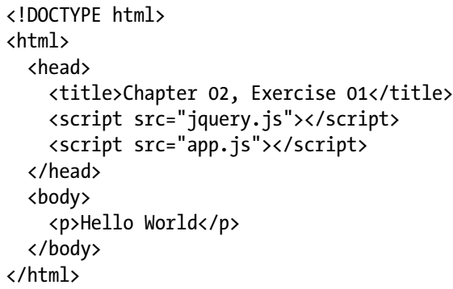
Listing J-1

Slide 60
NOTE
The order of the files being loaded with the script tag is very important.
Remember that the code you write is going to be dependent on jQuery, so you have to load jQuery before any scripts that use it.

Slide 61
Editing app.js
Go into app.js and add the following line—the first line of jQuery you’ve written in the book!
Can you guess what that does? You have already seen that $("body") selects the "body" tag (remember, they are just CSS selectors), and you can probably take a logical stab at what css("background", "red") does.
Refresh the page, and you … won’t see any change.
This is a mistake that many jQuery beginners make when starting out.
The problem is back in your index.html file – Listing J-1.
Load in your JavaScript before you load in the rest of the page, so when your JavaScript is executed, the page hasn’t fully loaded, which means the DOM is not ready.
Because the page isn’t fully loaded at the time your JavaScript is run, the browser hasn’t completed constructing the DOM, which means as far as the DOM is concerned, "body" doesn’t exist when your JavaScript runs.

Slide 62
Loading JavaScript
You have two options here:
Include your JavaScript at the bottom of the page, just before the closing </body>. This means it’s run after the DOM is loaded.
Tell your JavaScript not to execute until the DOM is ready.
In practice, it’s better to include JavaScript at the bottom so that it doesn’t delay the content loading.
So for most of this book, we’ll be doing that.
This time, however, we’re going to choose the second option— purely because we need to explain how you go about doing it.
In order to discuss how to stop your code from running until the DOM has loaded, we are going to talk briefly about events.
We will cover events in vast detail in Chapter 4, but you need to dip your toes in the topic now.
Within the browser, writing JavaScript is very much event based.
Write code that’s executed based on an event. The user clicks a button, scrolls down the page, hovers over an image, and so on.
Each of these actions causes an event to fire, which is grabbed by JavaScript, and then the code is executed based on that event occurring.

Slide 63
Animation Example

Slide 64
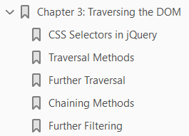
3
Traversing the DOM

Slide 65
Intro
You’ve seen how jQuery works and how to make animated boxes fade in and out.
Now it’s time to take a more methodical look at the library and explore everything it can do.
This chapter doesn’t cover every method jQuery has to offer because a lot of methods do very similar things.
There are also methods that do the exact opposite of each other.
For example, in Chapter 2, after looking at how fadeOut( ) works, you looked only briefly at fadeIn( ) because it was obvious what it would do, having met fadeOut( ).
There is a similar situation with a lot of jQuery methods. This chapter won’t simply be a documentation of all jQuery’s traversal methods, however.
Efficiency is a large part of this chapter—and it will be mentioned a lot.

Slide 66
Agenda
Here’s what this chapter holds:
Selecting elements with CSS selectors and exploring which are the most efficient.
Using jQuery pseudo-selectors.
Exploring the variety of traversal methods that jQuery provides.
Caching selectors and chaining methods to avoid reselecting elements.
Avoiding more DOM work than necessary. The bottleneck of any jQuery project is always the DOM interaction. Interacting with the DOM is expensive, so the fewer times you can do it, the better.

Slide 67
CSS Selectors in jQuery

Slide 68
Traversal Methods

Slide 69
Further Traversals

Slide 70
Chaining Methods

Slide 71
Further Filtering

Slide 72
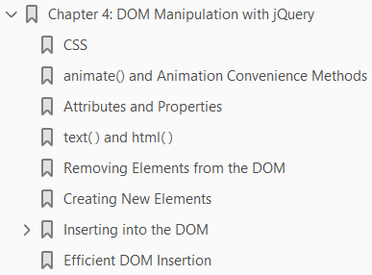
4
DOM Manipulation with jQuery

Slide 73
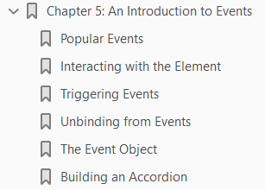
An Introduction to Events
5

Slide 74
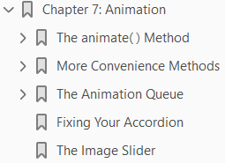
Animation
7

Slide 75
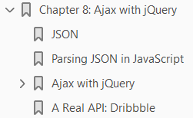
Ajax with jQuery
8

Slide 76
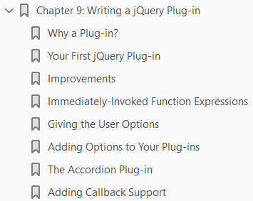
9
Writing a jQuery Plug-in

Slide 77
Intro
jQuery plug-ins are something that beginners tend to shy away from or are afraid to use.
Plug-ins seem to be built up in people’s minds as incredibly complex things to use, but once you learn how they work, you’ll find them actually very straightforward, and you’ll find yourself making multiple plug-ins while working.
Plug-ins are not as complicated as you might think, as this chapter will demonstrate.
After exploring the benefits of the plug-in and when to turn code into one, you will learn about different types of plug-ins, build a few small plug-ins to see how they work, and discover how to make them more configurable to a potential developer.
In the next chapter, you’ll take code that you’ve previously written, including the accordion you started in Chapter 5 and the Ajax code from Chapter 8, and turn them into fully functioning plug-ins.
You will then write a fully-featured, complex, image slider plug-in.
But for now, we’ll keep it simple.

Slide 78
Why a Plug-in?
There are typical patterns or signs you notice when writing code that are worthwhile to abstract into a plug-in.
If you find yourself imagining another project or situation in which some code you’ve written could be reused, that’s a good sign that you should turn it into a plug-in.
Your accordion code is a perfect example of this.
If you find yourself writing very similar code multiple times on different projects, it is a great sign that you should spend time producing a plug-in that can then be easily reused with little effort.
If you find yourself writing code to build a simple accordion more than once, it’s time to stop and build a plug-in.
It might take a bit longer initially, but afterward you’ve got a nice, self-contained plug-in that you will never have to write again.
Write once, benefit multiple times.
So far, we’ve spoken about plug-ins in the context of an accordion, but plug-ins can really be made for anything you find yourself doing a lot
It could be a small, three-line plug-in simply to make a certain action much easier, or it could be as large as a complicated image slider.

Slide 79
Your First jQuery Plug-in
Your first jQuery plug-in is going to be incredibly simple.
It’s just going to log out the value of the ID attribute for every element it’s called on.
Before writing a plug-in, it is useful to imagine how another developer will use your plug-in.
In this case, imagine doing the following:

Slide 86
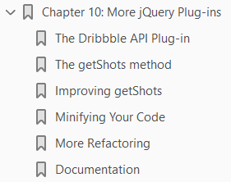
10
More jQuery Plug-ins

Slide 87
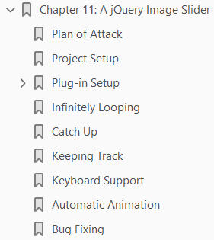
A jQuery Image Slider
11

Slide 88
jQuery Release History
jQuery History - Wiki
Events
Filters
Downloading jQuery
jQuery Methods
Selectors
jQuery Selectors for ASP.NET
jQuery Selectors for ASP.NET MVC

Slide 89
jQuery Release History
The jQuery project started as an inkling back in 2005 and has grown into the collection of projects that we know today.
In the sections that follow,

Slide 90
jQuery History Wiki
jQuery was originally released in January 2006 at BarCamp NYC by John Resig and was influenced by Dean Edwards' earlier cssQuery library
It is currently maintained by a team of developers led by Timmy Willison (with the jQuery selector engine, Sizzle, being led by Richard Gibson).

Slide 91
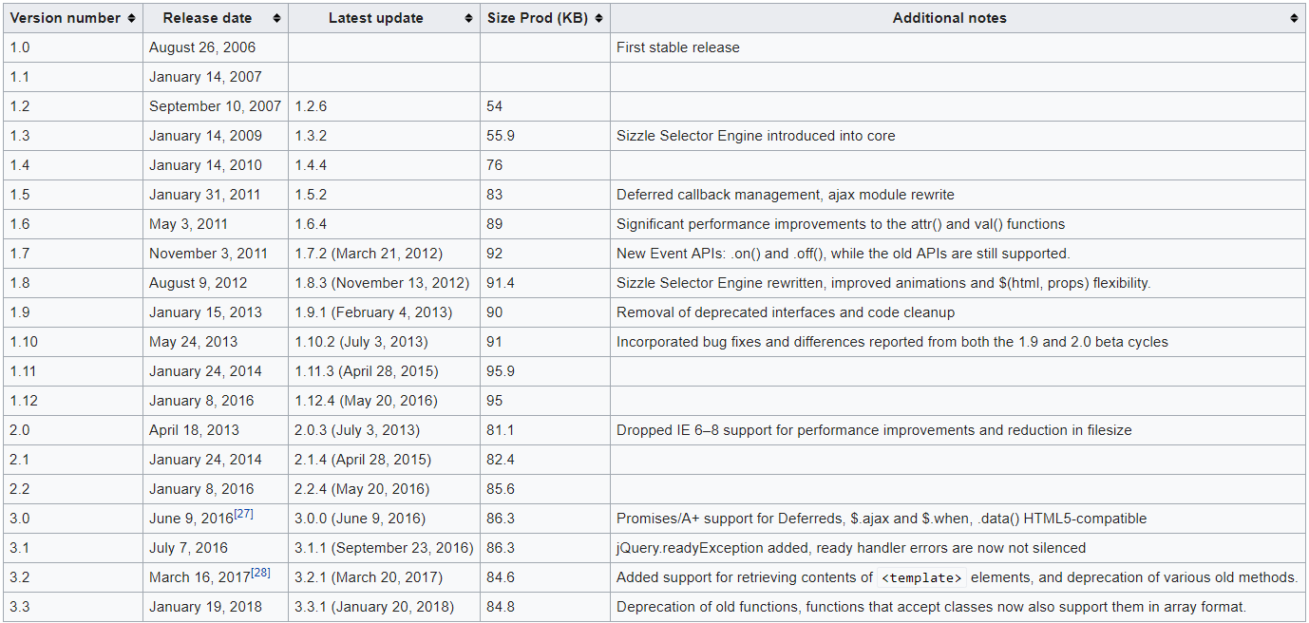
Release History

Slide 92
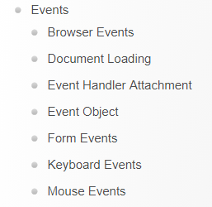
Events
These methods are used to register behaviors to take effect when the user interacts with the browser, and to further manipulate those registered behaviors.

Slide 93
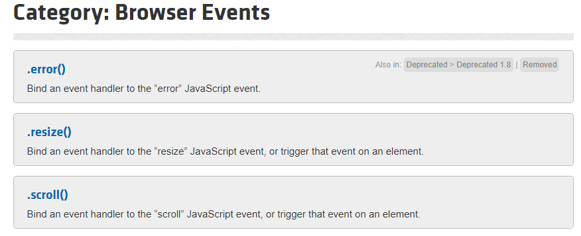
Browser Events

Slide 94
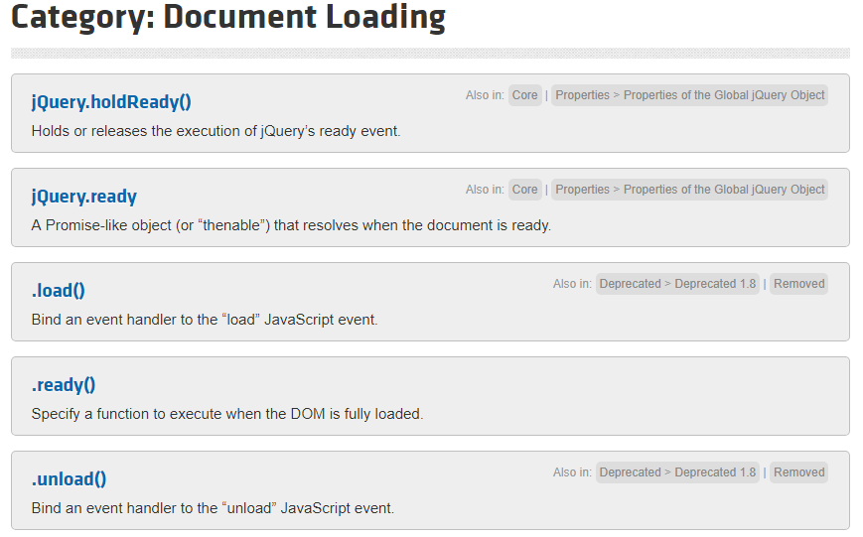
Document Loading

Slide 95
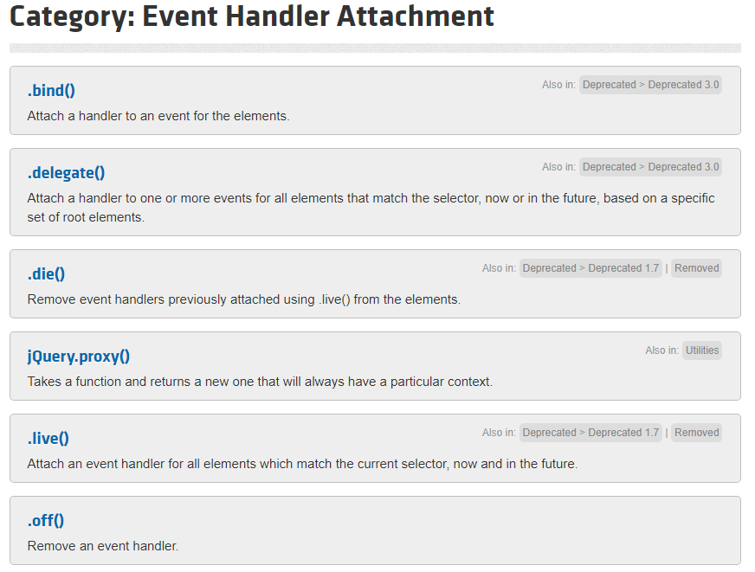
Event Handler Attachment

Slide 96
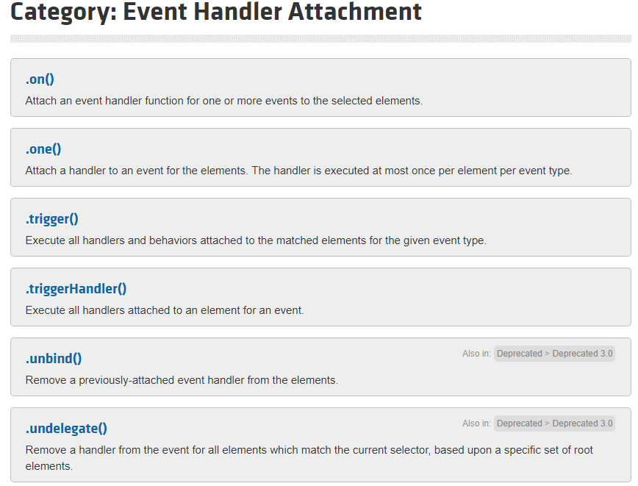
Event Handler Attachment |

Slide 97
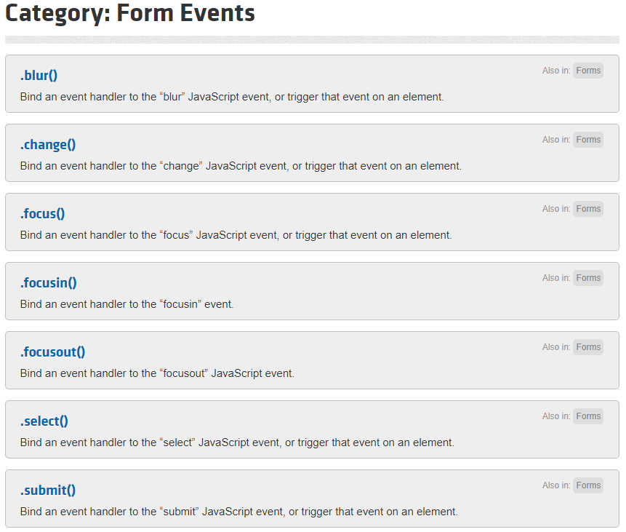
Form Events

Slide 98
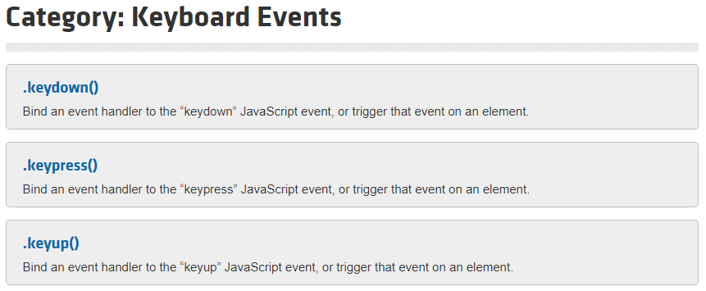
Keyboard Events

Slide 99
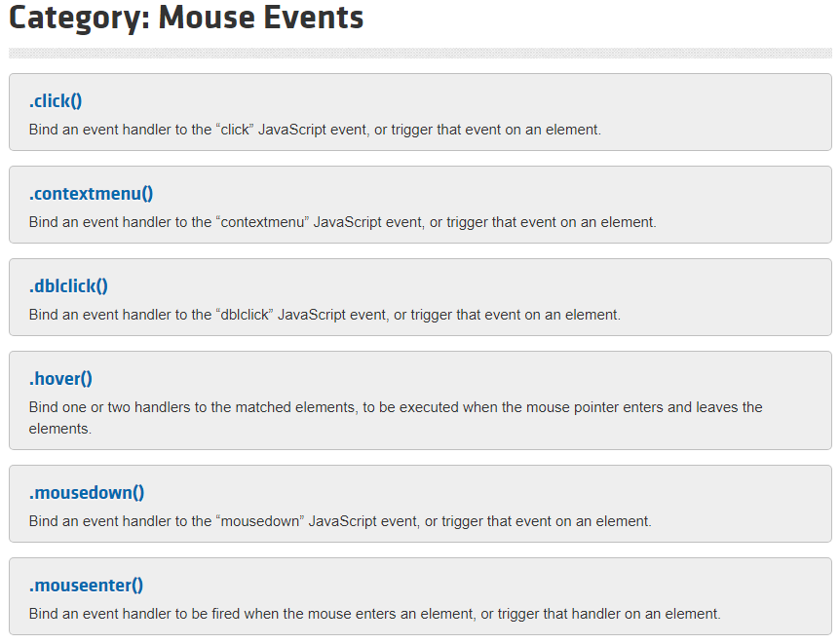
Mouse Events

Slide 100
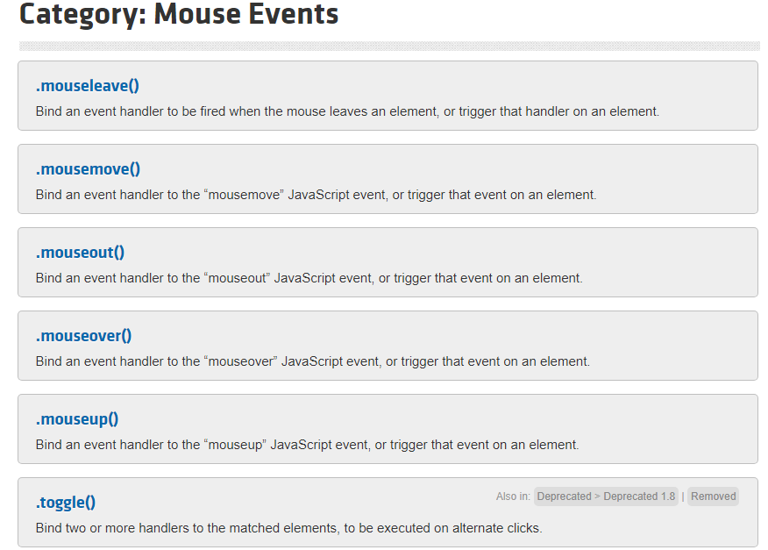
Mouse Events |

Slide 101
Filters
jQuery has the following types of filters:
Basic filters allow you to filter the results of other selectors. In the process, they enhance selectors by providing additional selection logic.
For example, an element selector can select all the <td> elements from a table.
But to work with the first or last <td> element, additional filtering is necessary, which is provided by basic filters.
Child filters allow you to work with child elements of their respective parents.
Using child filters, you can get specific child elements such as first child, last child, and a child at a specific position.
Content filters allow you to filter elements based on their content.
For example, you can select elements that contain certain text or you can select elements that contain some other elements.
Position filters: These selectors retrieve elements based on their position in a collection.

Slide 102
Filters |
Form filters allow you to select <form> elements based on their type (such as text box, check box, and radio button) or their status (such as selected, checked, and disabled).
Form selectors are widely used when developing data-driven web applications and also when data-bound ASP.NET controls, such as GridView and DetailsView, are being used.
Hierarchy filters allow you to work with child and sibling elements.
Whenever you used $("#GridView1 tr"), you were actually using one of the hierarchy selectors: the Descendant selector.
Visibility filters allow you to select either hidden or visible elements.
An element is considered hidden if it has the CSS display property set to none, it is an <input> element with type hidden, or its height and width are both 0.
The setting of the CSS visibility property is not taken into account when deciding whether an element is visible or hidden.

Slide 103
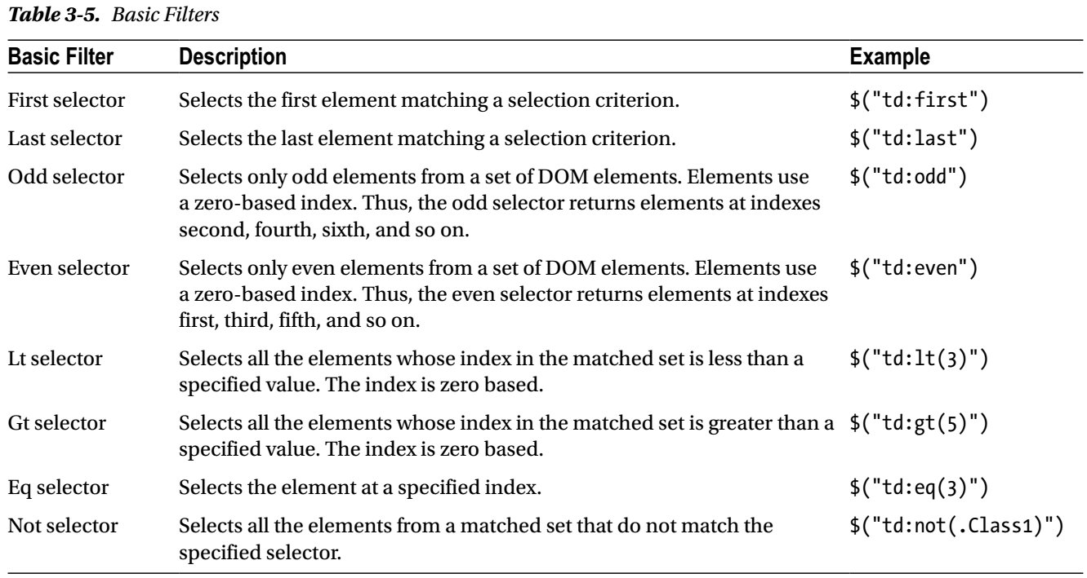
Basic Filters

Slide 104

Child Filters

Slide 105

Content Filters

Slide 106

Position Filters

Slide 107

Form Filters

Slide 108

Hierarchy Filters

Slide 109

Visibility Filters

Slide 110
Downloading jQuery
Following are the steps to download jQuery:
Launch any web browser and enter the URL http://www.jquery.com to access the jQuery home page:
Click on the Download jQuery button
jQuery is available in two different major versions at the time of writing:
Version 1.x
Version 2.x
Though the Application Programming Interface (API) is the same for both major versions, the difference lies in the support offered for certain browsers.
The 2.x line does not support old browsers, such as IE 6, 7, and 8, while the 1.x line continues with this support.
So, if the end users of your application will not be using old browsers, you can download the 2.x version.

Slide 111
jQuery Library
The jQuery library consists of a single JavaScript (.js) file and can be downloaded in the following formats:
Uncompressed format: This is used in a development environment or when debugging the code.
Compressed format: This is used in a production (that is, release) environment. It is compact and uses low bandwidth. It is commonly referred to as the minified version.

Slide 112

jQuery Library: Naming Convention
The compressed (minified) version is clearly distinct from the uncompressed version because of the .min.js extension.
The minified file uses code optimization techniques, such as removing whitespaces and comments as well as reducing variable names to one character.
This version is difficult to read, so the uncompressed version is preferred when debugging.
On the download page, there is also a map file available with the .min.map extension.
Sometimes, when bugs appear in the production environment necessitating troubleshooting, the use of the minified file for debugging can be difficult.
The map file simplifies this process.
It maps the compressed file back to its unbuilt state so that during debugging, the experience becomes similar to using the uncompressed version.

Slide 113
jQuery Methods
Consider the Listing A-1 and A-2.

Slide 114

Listing A-1

Slide 115

Listing A-2

Slide 116
Selectors
A web page is composed of a variety of HTML elements, such as form, div, span, paragraph, hyperlink, table, input, select, and so on.
When writing a client script, there is often a need to manipulate these elements.
In JavaScript, it is possible to access these elements using their unique IDs with the help of the document.getElementById( ) statement.
However, in real-world applications, there might be a requirement to retrieve elements based on attributes other than their IDs.
Or some applications may require retrieval and manipulation of more than one element. This is made possible by the use of selectors in jQuery.
A selector is a jQuery construct that retrieves elements on a page based on a specified condition.
It can be used to return single or multiple elements.
Using jQuery selectors, it is possible to match elements using their ID, CSS class, tag name, and position in the Document Object Model (DOM) or other attributes.

Slide 117
jQuery Selectors for ASP.NET
When an ASP.NET page is viewed in the browser, the controls are rendered as HTML elements.
This makes it possible to select ASP.NET controls using standard jQuery selectors.
To perform operations such as event handling, changing CSS properties, or getting or setting the element content of any DOM element, you first need to get that element.
In situations where only one element is involved, things are quite easy because JavaScript and the HTML DOM allow you to access elements by their IDs.
However, often you need to select elements from a web page based on some complex criteria.
That is where jQuery selectors come into the picture.
jQuery selectors are the jQuery constructs that allow you to select DOM elements based on variety of criteria.
Many of the jQuery selectors are based on CSS (versions 1–3) selectors, and jQuery adds more to the list.
Listing M-1 and Table 3-2 shows the selectors for ASP.NET.

Slide 118

Listing M-1

Slide 119

Table 3-2

Slide 120
jQuery Selectors for ASP.NET MVC
Standard jQuery selectors can also be used with ASP.NET MVC since MVC applications use raw HTML markups or built-in extension methods of the HTML class to render the content.
The Table 3-12 shows the HTML Helper methods used by ASP.NET MVC and the corresponding HTML tags generated.

Slide 121

Table 3-12

